Slide 1
Intro to NoSQL
COMP / IT 420
April 12th, 2021

Slide 2
Updates and Announcements
Database Part 4 Assignment Now Live and due May 23rd, 2021
Homework 4 due next Tuesday, April 20th, 2021
Be sure to install MongoDB and Studio 3T / Robo 3T if you have not.
Lab time on Wednesday will review some further MongoDB setup and such.

Slide 3
Updates and Announcements
Next week is Neo4j and graph databases.
Install Neo4j Desktop https://neo4j.com/download/ if you want a simple package. You can also deploy through docker or install through a package manager.
Lab 9 and 10 are both on new NoSQL paradigms.
Optional Homework 5 is on more advanced applications of MongoDB and Neo4j.

Slide 4
Database Part 4: Implementation
Three components:
DDL file describing your database
DML file containing all of your:
Views (5)
Procedures (12)
Triggers (3)
Graphical Application
Design your application to connect to your CIKeys instance (once submitted) or to recreate your database in a local MySQL instance.

Slide 5

Today’s Topics
NoSQL Paradigms
Key-Value Stores
Document Stores
Big Column (Table) Stores
Graph Databases
Beginning MongoDB

Slide 6
Big Data?
Velocity – Incoming scale of the stream of data
Volume – Amount of data, outstripping previous models
Variety – Unstructured or Semi-Structured Data

Slide 7
RDBMS Limitations
Velocity – Distributed management is difficult
Volume – Scaling up versus scaling out; row-based storage is memory inefficient and slow
Variety – RDBMS expect structured data

Slide 8
Motivation for NoSQL
Scalability – clustering is better and easier than upgrade
Cost – Open-source, cheaper than enterprise RDBMS
Flexibility – “Schema-less” design for reactive data
Availability – Distributed for fault-tolerance

Slide 9
NoSQL
“Not Only” SQL or “Not Just” SQL…
from a Twitter conference hashtag!
From Eric Evans:
“My regret however isn’t about what the name says, it’s about what it doesn’t. When Johan originally had the idea for the first meetup, he seemed to be thinking Big Data and linearly scalable distributed systems, but the name is so vague that it opened the door to talk submissions for literally anything that stored data, and wasn’t an RDBMS.”

Slide 10
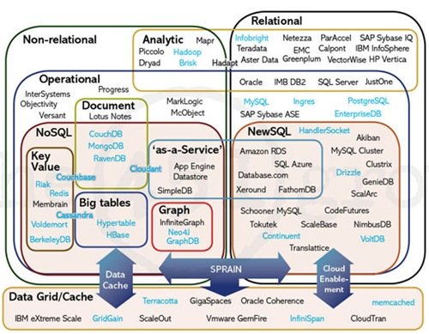

Slide 11
A Need for NoSQL
Explosion of social media (Facebook, Twitter, YouTube) with large data needs
Rise of cloud-based solutions such as Amazon S3 (simple storage solution)
Just like moving to dynamically-typed languages (Ruby/PHP), a shift to dynamically-typed data with frequent schema changes
Agile Development
Open-source community

Slide 12
ACID vs BASE
Atomicity
non-divisible transactions
Consistency
consistent state after transaction
Isolation
invisible until complete
Durability
persistent data storage

Slide 13
ACID vs BASE
Basically Available
partial failure allowed
Soft State
overwrite and expiration
Eventually Consistent
may not update at once

Slide 14
CAP Theorem
Consistency
every read returns most recent write
Availability
always respond, maybe without current data
Partition Tolerance
operate through failures

Slide 15
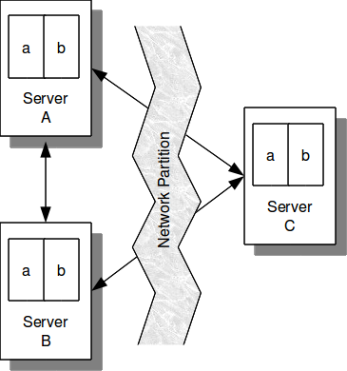
Partition Tolerance
If a network node is cutoff
due to communication failure
it is not possible to serve consistent
information. However, results are still
available (but may not be most recent).

Slide 16
CAP Theorem
When the network fails, choose one!
Cancel operation = Not available but consistent
Return operation = Available but not consistent

Slide 17
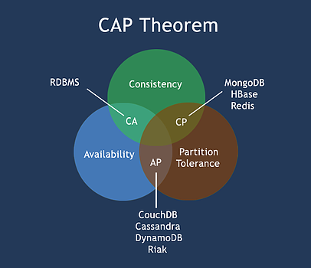
Neo4j
CA only makes sense
with monolithic
systems and even then
not totally

Slide 18
Major Research Papers on NoSQL
Towards Robust Distributed Systems (2000)
Eric Brewer (CAP presentation)
BigTable (2006)
Google
DynamoDB (2007)
Amazon

Slide 19
NoSQL Categories
Key-Value Pair
Document
Column Family
Graph

Slide 20
NoSQL Categories
Key-Value Pair – associated key and value store
Document – KV pair with document tags
Column Family – KV pair with column groups
Graph – graph, node and edge store

Slide 21
NoSQL Categories
Key-Value Pair
1. simplest NoSQL option
2. unsorted associative array
3. identifier maps to data value

Slide 22
Key Value Pair DB
cust1.address = “1 University Drive”
cust1.name = “Barry”
cust1.accountNumber = “123456”

Slide 24
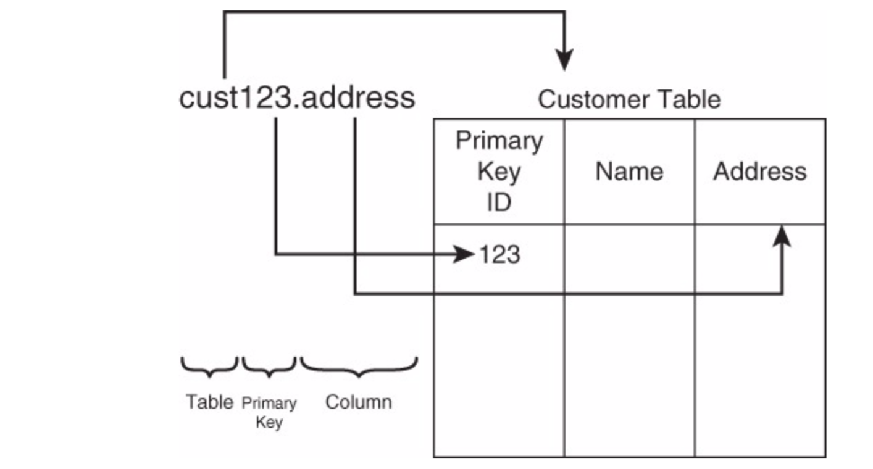
Key Value Pair DB

Slide 25
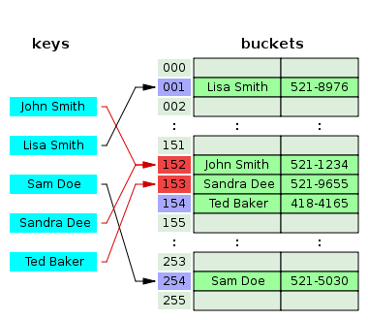
The Hash Table
Type | Unordered associative array
Invented | 1953
Time complexity in big O notation
 | Average | Worst case
Space | O(n) | O(n)
Search | O(1) | O(n)
Insert | O(1) | O(n)
Delete | O(1) | O(n)

Slide 26
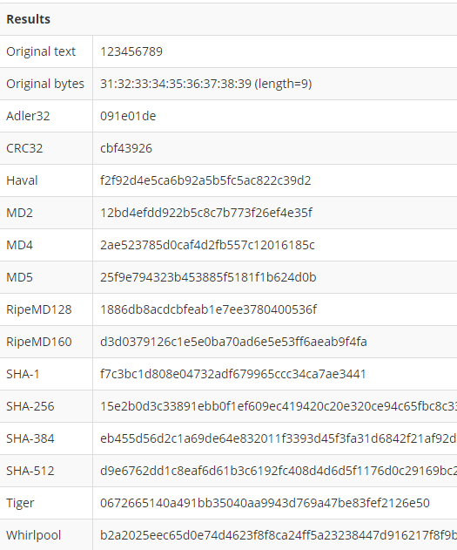
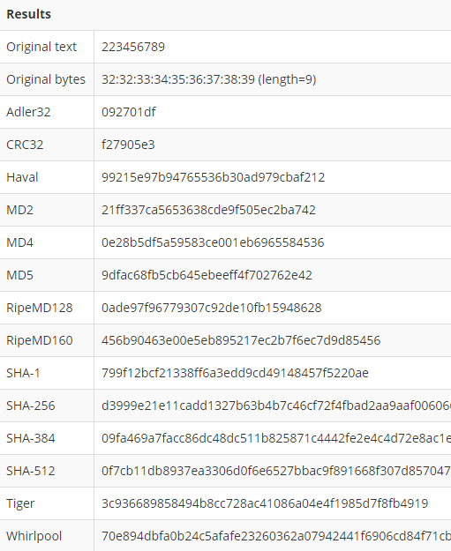
Hashing Results

Slide 27
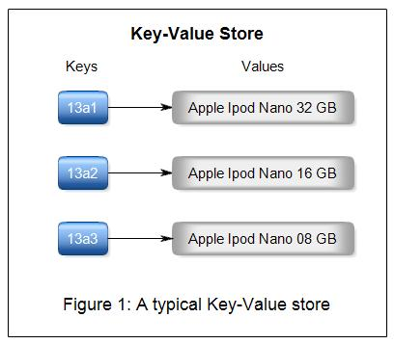
Benefits of KVP
Fault-tolerance - Continue operating even during failures.
Queries – Easy way of accessing data.
Storage options – Large array of hardware options are available.
Data replication – Data is effectively and efficiently transferred from one system to another.
Predictable latency – Detect and avoid bottlenecks.
Tunable consistency - Consistency can be configured per cluster, data center, or individual I/O operation.

Slide 28
[Wide] Column Store
Sub-type of key-value database.
Uses tables, rows, and columns, but unlike a relational database, columns are created for each row rather than being predefined by the table structure
Examples: Google BigTable, Apache Cassandra

Slide 29
Columns and Column Families
Column: The basic unit in a wide-column database and consists of a key and value pair.
Column family: Each row in the column family has a unique identifier key, and then as many columns as it needs to hold the information.
UserProfile = {
Cassandra = {emailAddress:"cassandra@apache.org", age:20},
TerryCho = {emailAddress:"terry.cho@apache.org", gender:"male"},
EKaltman= {emailAddress:“eric.kaltman@csuci.edu", gender:“male", address:“Camarillo"},
}

Slide 30
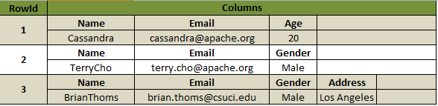
Wide Column Store Example
The first row contains three columns, one called “name”, “email” and “age”; but the third row contains different columns for Gender and Address, but not Age.
Rows are flexible and can have different arrangements of columns.

Slide 31
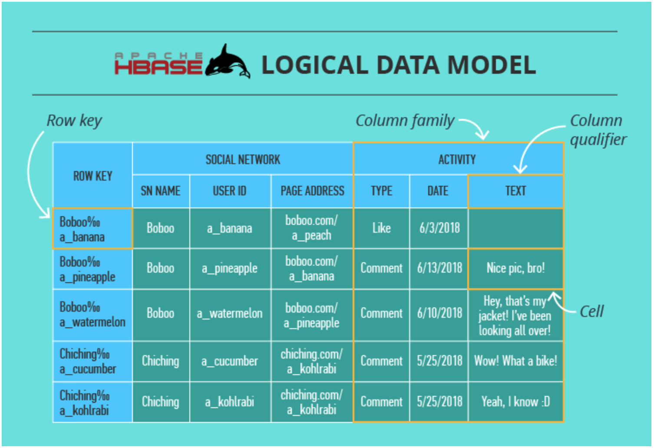

Slide 32
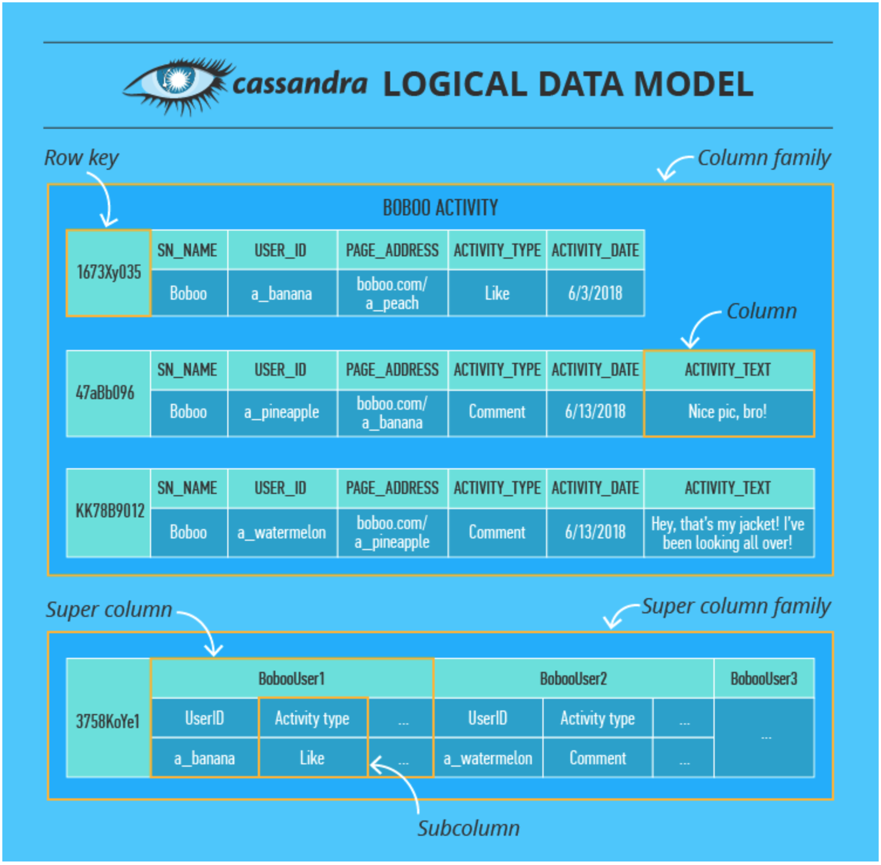
https://www.scnsoft.com/blog/cassandra-vs-hbase

Slide 33
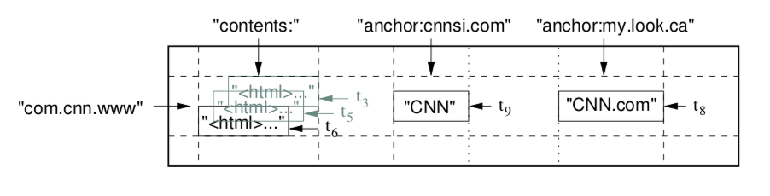
“contents” and “anchor” are column family designations
“contents” is indexed by timestamp sorted by most recent update
“com.cnn.www” indexes the unique row in the database
Why is it backwards?
com.google.maps
com.google.images
same domains stored close together

Slide 34
Wide-Column Benefits
High Scalability means it’s well-suited for distribution across multiple data stores and computing nodes.
Sorting and some data manipulation occurs directly from the database rather than relying solely on the application.
Indexing at different levels of columns helps with data processing.
Increased granularity allows updates at the individual column rather than having to replace all of the data when something changes.

Slide 35
Graph Databases
Uses graph structures for semantic queries with nodes, edges and properties to represent and store data.
Based on property-graph model:
Nodes represent entities.
Properties are characteristics of nodes.
Edges connect nodes and represent relationships.
Important information is mostly stored in the edges.
Patterns emerge in examining the interconnections of nodes, properties, and edges.

Slide 36
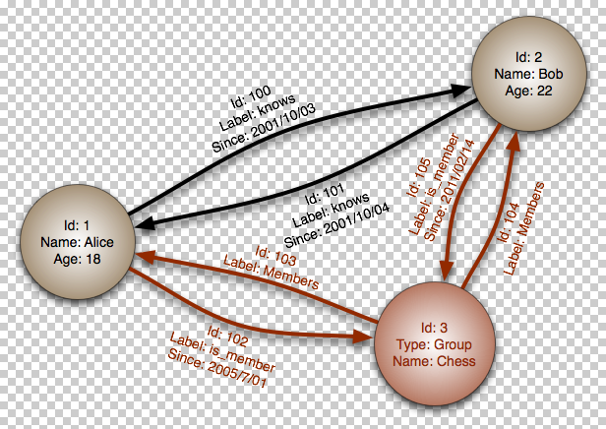
Graph Database Example (1)

Slide 37
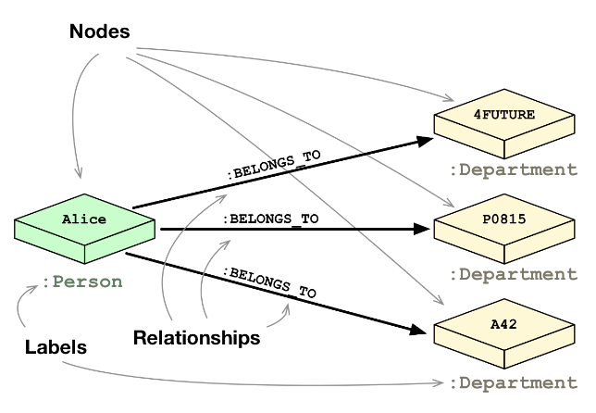
Graph Database Example (2)

Slide 38
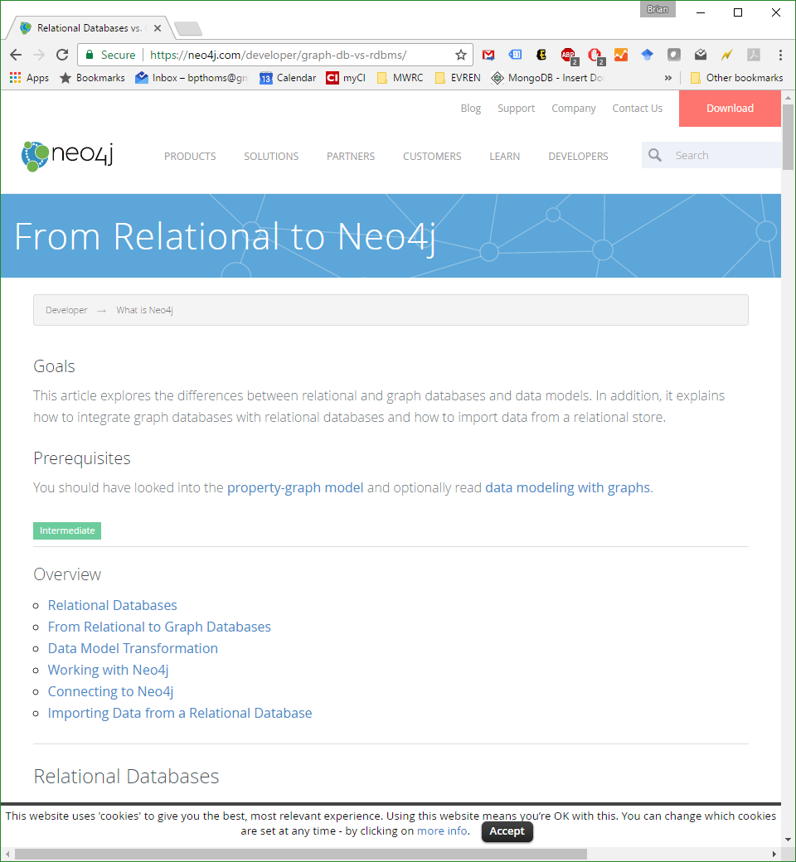
neo4j

Slide 39
Document Store
Designed for storing, retrieving, and managing document-oriented information, also known as semi-structured data.
Inherently a subclass of the key-value store.
Internal data structure
Key-value stores opaque data
Document stores metadata
Examples: MongoDB, CouchDB, Amazon SimpleDB.

Slide 40
Document Store Example Query
> db.user.findOne({age:39})
{
"_id" : ObjectId("5114e0bd42…"),
"first" : "John",
"last" : "Doe",
"age" : 39,
"interests" : [
"Reading",
"Mountain Biking
]
"favorites": {
"color": "Blue",
"sport": "Soccer"}
}

Slide 41
Relational vs. Document
Relational | Document
Database | Database
Table, View | Collection
Row | Document (JSON, BSON)
Column | Field
Index | Index
Join | Embedded Document
Foreign Key | Reference
Partitioning | Sharding
Notes:
Javascript

Slide 42

MongoDB
Stands for huMONGOus database.
NoSQL, document-oriented database.
Open-source under GNU AGPL and the Apache License since 2007.
Easy to install and use
Detailed documentation
Various APIs
JavaScript, Python, Ruby, Perl, PHP, Java, Java, Scala, C#, C++, Haskell, Erlang

Slide 43
Document Store
Designed for storing, retrieving, and managing document-oriented information, also known as semi-structured data.
Inherently a subclass of the key-value store.
Internal data structure
Key-value stores opaque data (typing not surfaced)
Document stores metadata
Examples: MongoDB, CouchDB, Amazon SimpleDB.

Slide 44
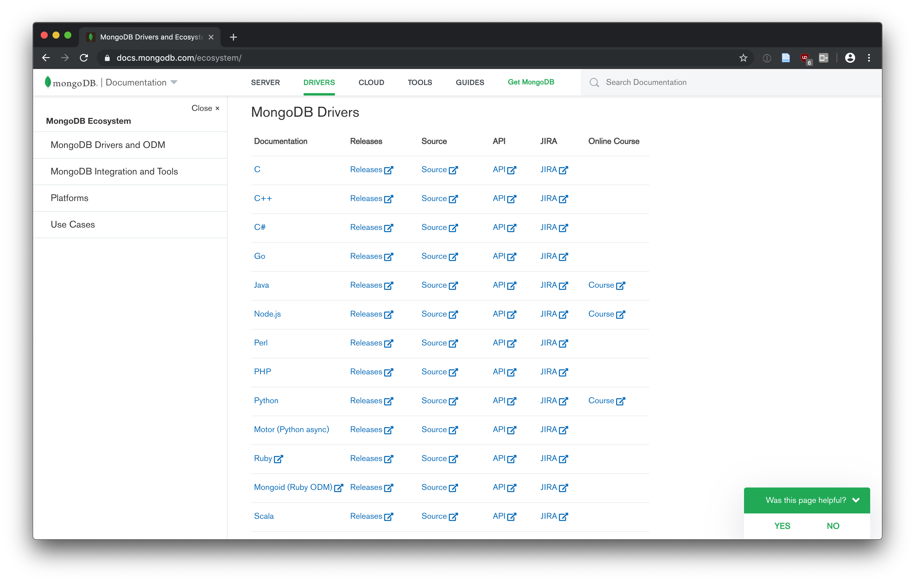

Slide 45
MongoDB Example Query
> db.user.findOne({age:39})
{
"_id" : ObjectId("5114e0bd42…"),
"first" : "John",
"last" : "Doe",
"age" : 39,
"interests" : [
"Reading",
"Mountain Biking
]
"favorites” : {
"color": "Blue",
"sport": "Soccer”
}
}

Slide 46
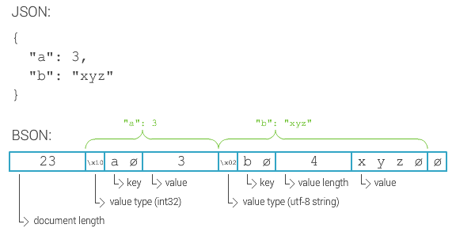
MongoDB Documents
Favors JSON-like documents, called BSON.

Slide 47
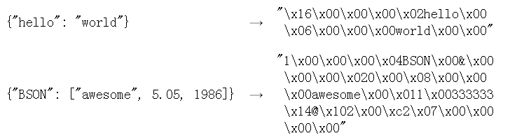
BSON
A binary format in which zero or more key/value pairs are stored as a single entity.
Lightweight, traversable, efficient.

Slide 48
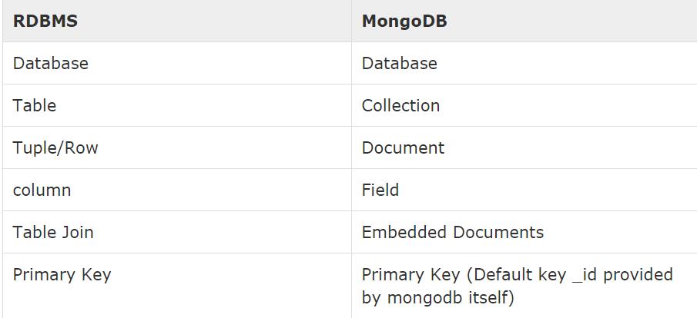
RDBMS vs MongoDB

Slide 49
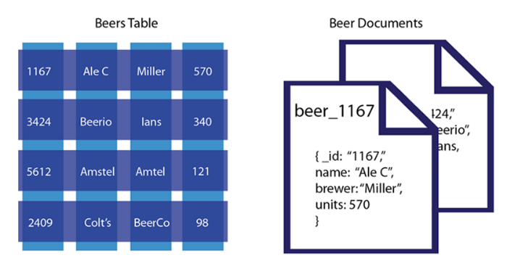

Slide 50
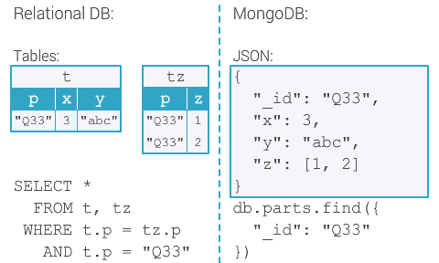

Slide 51
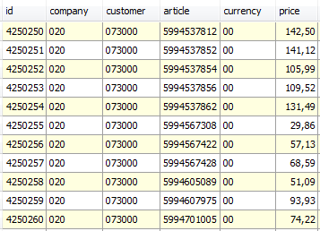
Horizontal Partitioning (sharding )
Separates very large databases (i.e. files) into smaller, faster, more easily managed parts called data shards (small part of a whole).
Partitions data
Scales write throughput
Increases capacity
Auto-balances
shard₁
shard₂
Host1:10000
Host2:10010
configdb
Host3:20000
Host4:30000
Client

Slide 52
Sharding Example
A BSON document (which may have significant amounts of embedded data) resides on a single shard.
Sharding is the partitioning of data among multiple machines in an order-preserving manner.
Machine 1 | Machine 2 | Machine 3
Alabama → Arizona | Colorado → Florida | Arkansas → California
Indiana → Kansas | Idaho → Illinois | Georgia → Hawaii
Maryland → Michigan | Kentucky → Maine | Minnesota → Missouri
Montana → Montana | Nebraska → New Jersey | Ohio → Pennsylvania
New Mexico → North Dakota | Rhode Island → South Dakota | Tennessee → Utah
 | Vermont → West Virgina | Wisconsin → Wyoming

Slide 53
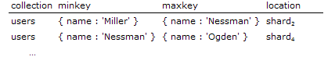
Shard Keys
Data is distributed at the collection level using a shard key.
Can be an indexed field or an indexed compound field that exists in every document in the collection.
Uses hash-based or range-based sharding.

Slide 54
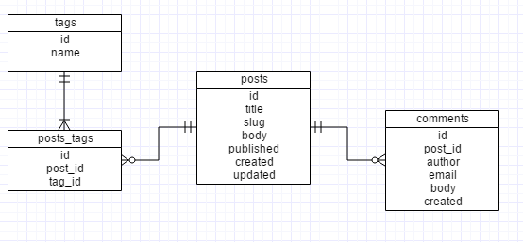
RDBMS Schema Design

Slide 55
MongoDB Schema Design
No predefined data schema.
Each document may have different data and different formats for data.
Relationships exist through embedding or linking.
Embedding is the nesting of objects and arrays inside a BSON document (prejoined). Results in the duplication of data.
Linking references documents (client-side follow-up query).

Slide 56
Mongo Document
The field name _id is reserved for use as a primary key; its value must be unique in the collection, is immutable, and may be of any type other than an array.
The field names cannot start with the $ character.
The field names cannot contain the . character.
$ is used to reference the value of a field of the current document or to prefix a call to an operator
Notes:
Create
The field name _id is reserved for use as a primary key; its value must be unique in the collection, is immutable, and may be of any type other than an array.
The field names cannot start with the $ character.
The field names cannot contain the . character.
Create with save
If the <document> argument does not contain the _id field or contains an _id field with a value not in the collection, the save() method performs an insert of the document.
Otherwise, the save() method performs an update.

Slide 57
Mongo Document
MongoDB is case-sensitive, so pay attention when writing commands.
Keys need to be unique for each document since it is an associative array.
{“hello”: “world”, “hello”: ”neighbor”}
Second “hello” is invalid.
Notes:
Create
The field name _id is reserved for use as a primary key; its value must be unique in the collection, is immutable, and may be of any type other than an array.
The field names cannot start with the $ character.
The field names cannot contain the . character.
Create with save
If the <document> argument does not contain the _id field or contains an _id field with a value not in the collection, the save() method performs an insert of the document.
Otherwise, the save() method performs an update.

Slide 58
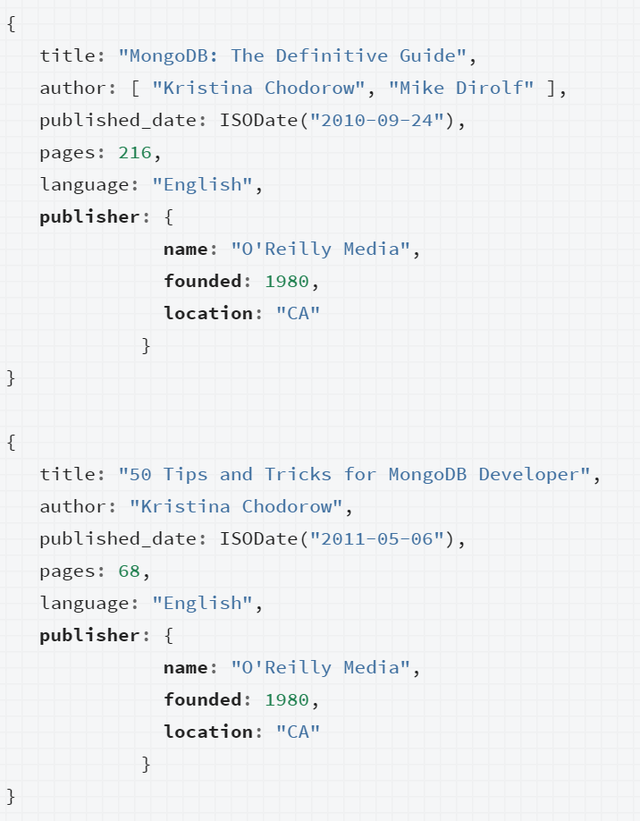
MongoDB Relationships
Represent how various documents are logically related to each other.
Can be modeled via Embedded and Referenced approaches.
Relationships can be either 1:1, 1:M or M:N.

Slide 59
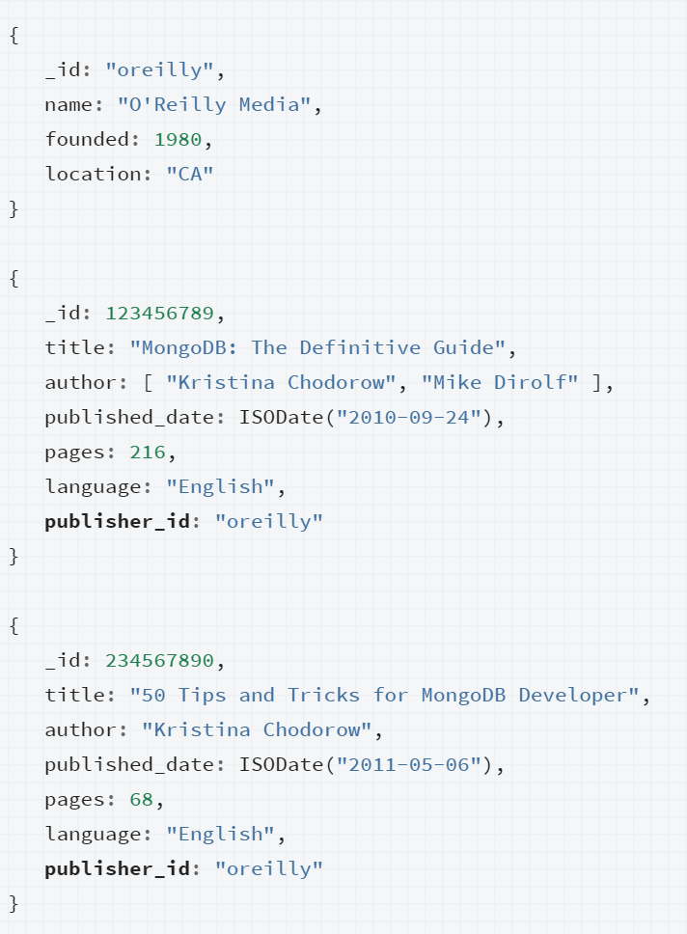
MongoDB Relationships
Represent how various documents are logically related to each other.
Can be modeled via Embedded and Referenced approaches.
Relationships can be either 1:1, 1:M or M:N.

Slide 60
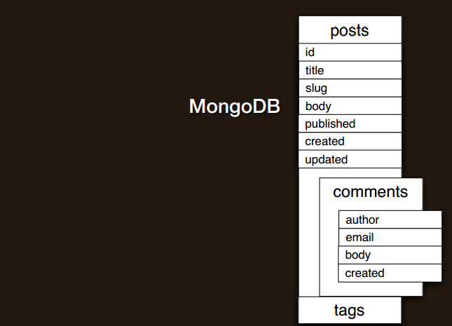
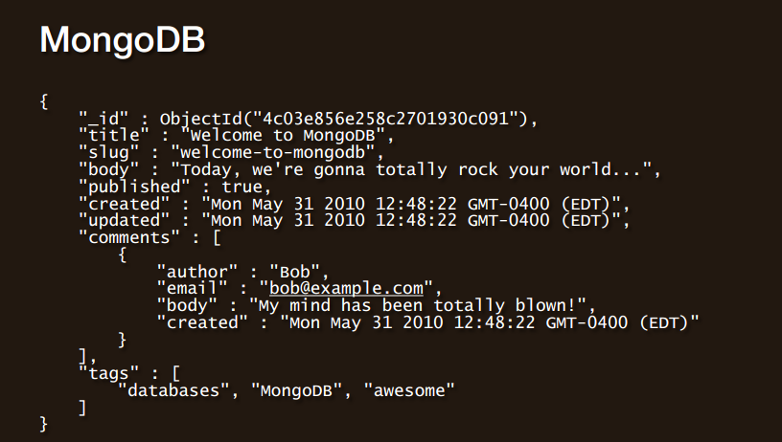
Schema Design

Slide 61
CRUD
Create – add documents to the collection
Read – retrieve objects (or documents)
Update – update documents
Delete – delete fields or documents

Slide 62
Create
db.collection.insert( <document> )
db.collection.insertOne( <document> )
db.collection.insertMany( <document> )
Notes:
Create
The field name _id is reserved for use as a primary key; its value must be unique in the collection, is immutable, and may be of any type other than an array.
The field names cannot start with the $ character.
The field names cannot contain the . character.
Create with save
If the <document> argument does not contain the _id field or contains an _id field with a value not in the collection, the save() method performs an insert of the document.
Otherwise, the save() method performs an update.

Slide 63
Read
db.collection.find( <query>, <projection> )
db.collection.findOne( <query>, <projection> )
Notes:
Create
The field name _id is reserved for use as a primary key; its value must be unique in the collection, is immutable, and may be of any type other than an array.
The field names cannot start with the $ character.
The field names cannot contain the . character.
Create with save
If the <document> argument does not contain the _id field or contains an _id field with a value not in the collection, the save() method performs an insert of the document.
Otherwise, the save() method performs an update.

Slide 64
Update and Delete
db.collection.update( <query>, <update>, <options> )
db.collection.remove( <query>, <justOne> )

Slide 65
CRUD Example
> db.user.insert({
first: "John",
last : "Doe",
age: 39
})

Slide 66
CRUD Example
> db.user.find () {
"_id" : ObjectId("51…"),
"first" : "John",
"last" : "Doe",
"age" : 39
}

Slide 67
CRUD Example
> db.user.update(
{"_id" : ObjectId("51…")},
{
$set: {
age: 40,
salary: 7000}
}
)

Slide 68
CRUD Example
> db.user.remove({
"first": /^J/
})
Regex

Slide 69
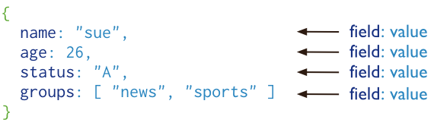
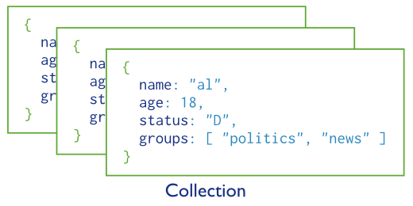
Basic operations
users

Slide 70
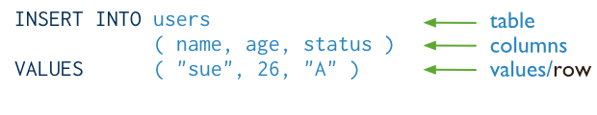
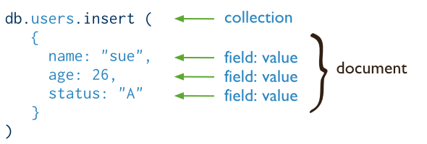
Insert a new user.
SQL
MongoDB

Slide 71
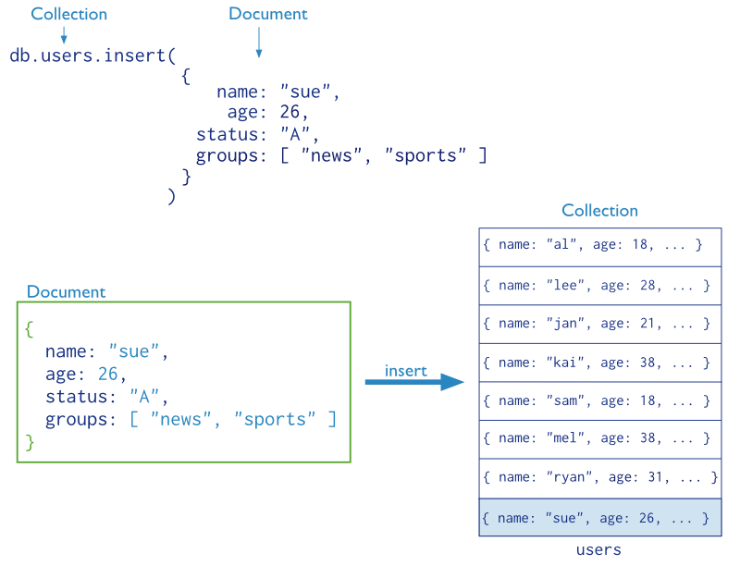

Slide 72
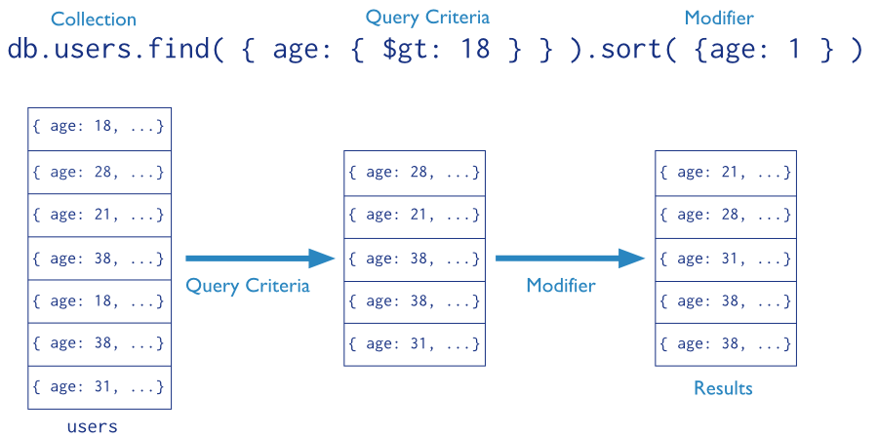
Find the users of age greater than 18 and sort by age.

Slide 73

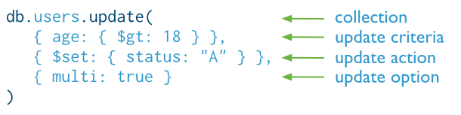
Update the users of age greater than 18 by setting the status field to A.
SQL
MongoDB

Slide 74

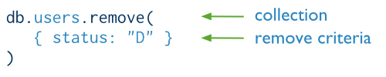
Delete the users with status equal to D.
SQL
MongoDB

Slide 75
Querying Data db.mycol.find().pretty()
RDBMS Equivalent | MongoDB Syntax
where lname = 'kaltman' | db.mycol.find({"lname":"kaltman"}).pretty()
where likes < 50 | db.mycol.find({"likes":{$lt:50}}).pretty()
where likes <= 50 | db.mycol.find({"likes":{$lte:50}}).pretty()
where likes > 50 | db.mycol.find({"likes":{$gt:50}}).pretty()
where likes >= 50 | db.mycol.find({"likes":{$gte:50}}).pretty()
where likes != 50 | db.mycol.find({"likes":{$ne:50}}).pretty()

Slide 76
CITIES Collection
﻿{
"_id" : "01001",
"city" : "AGAWAM",
"location" : [
-72.622739,
42.070206
],
"population" : 15338,
"state" : "MA"
}
_id = ZIP CODE

Slide 77
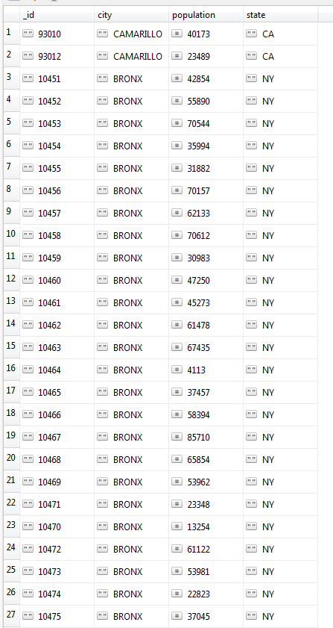
Compound Query with Sorting
db.collection.find( <query>, <projection>)
db.cities.find(
{ $or: [
{“city”: “CAMARILLO”},
{“city”:”BRONX”}
]
},
{
“city”: 1,
“state”:1,
“population”: 1
}
).sort({“city”:-1})

Slide 78
Aggregation Pipeline
The MongoDB aggregation pipeline is a way to filter document sets to arrive at a target collection of information
Basically, selecting from whole collection and piping each step to the next operator. The final result is defined by the last operation.

Slide 79
Aggregation Syntax
db.collection.aggregate(
[
{
${operator0}: {arguments}
},
{
${operator1}: {arguments}
},
...
]
);

Slide 80
MongoDB Aggregate
db.cities.aggregate([
{$match: {}},
{$group: {_id: “$city”,
total: {$sum: “$population”}}}
])
input query
output document form
Match all documents, all fields return a document
grouped by “city” with a “total” sum of population

Slide 81
MongoDB Aggregate
db.cities.aggregate([
{$match: {}},
{$group: {_id: “$city”,
total: {$sum: “$population”}}}
])
input query
output document form
SELECT city, sum(population)
FROM cities
GROUP BY city;

Slide 82
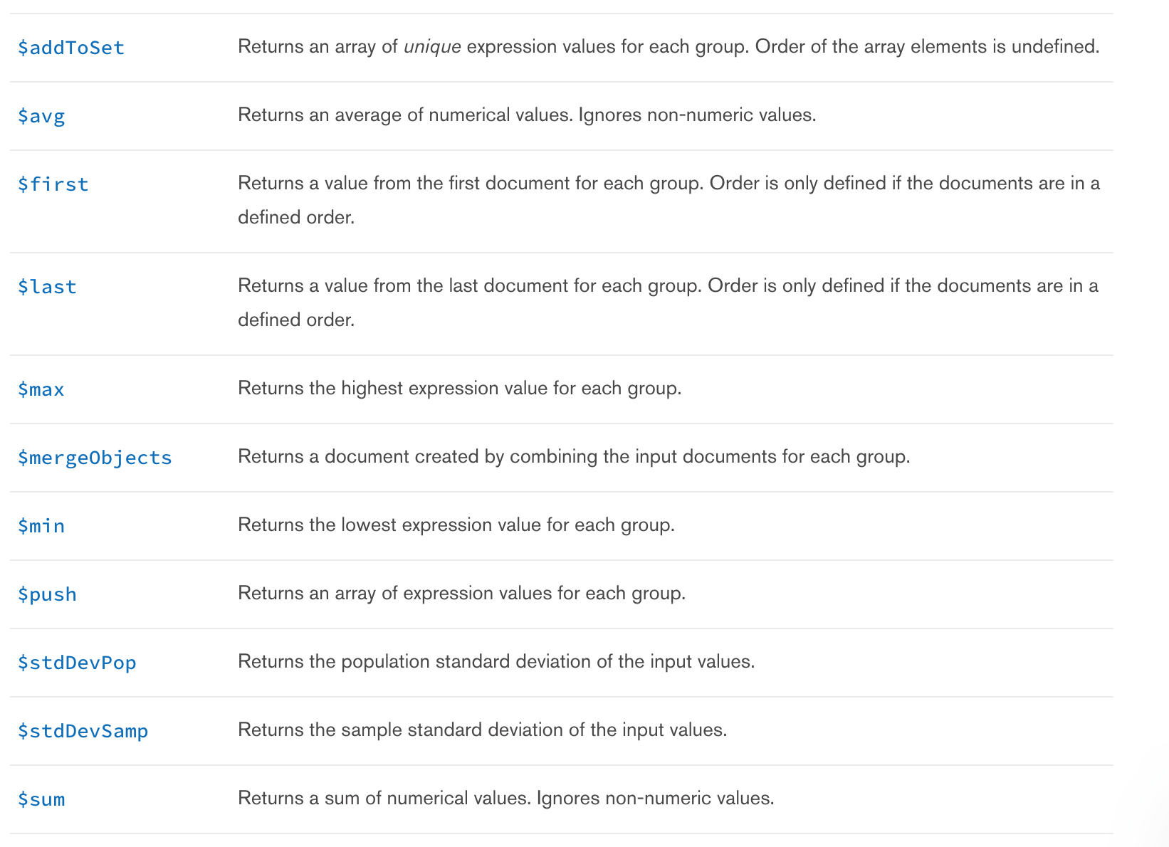

Slide 83
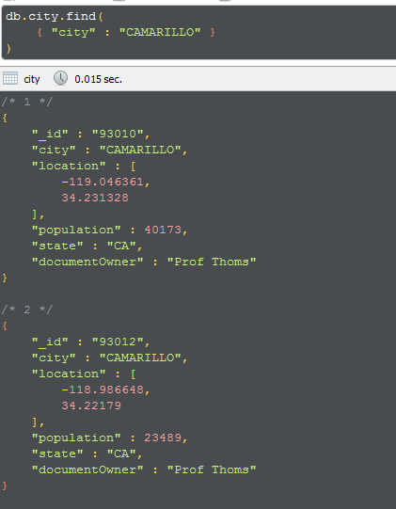
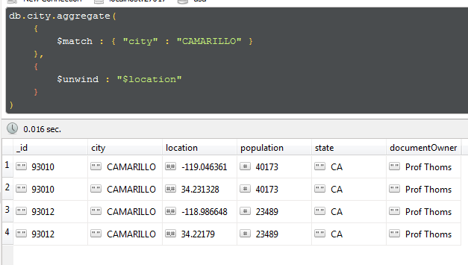
$unwind by Location

Slide 84
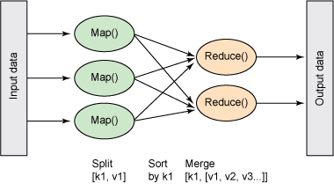
Map Reduce
A data processing paradigm for condensing large volumes of data into useful aggregated results.
Supports operations on sharded collections
Inspired by map() and reduce() functions used in functional programming.

Slide 85
MapReduce
map() function - A JavaScript function that associates or “maps” a value with a key and emits the key and value pair
reduce() function - A JavaScript function that “reduces” to a single object all the values associated with a particular key.
values DO NOT need to just be numbers

Slide 86
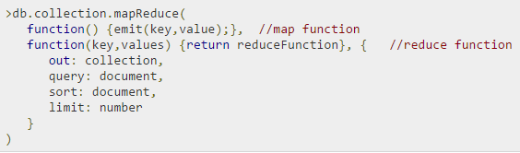
map: Function that maps a value with a key and emits a key-value pair
reduce: Function that reduces or groups documents having the same key
out: Specifies the location of the map-reduce query result
[query]: Specifies optional selection criteria for selecting documents
[sort]: Specifies optional sort criteria
[limit]: Specifies optional maximum number of documents to be returned

Slide 87
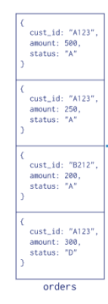
MapReduce Example
Consider the following document structure storing customer orders.
The document stores a cust_id, amount and status.
{ “cust_id“ : “A123", “amount“ : “500", “status“ : “A" }

Slide 88
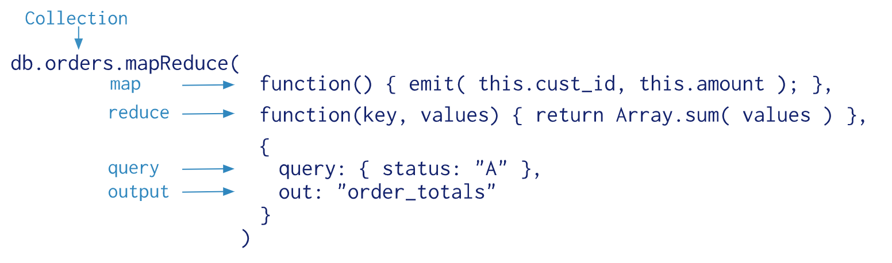
MapReduce Example

Slide 89
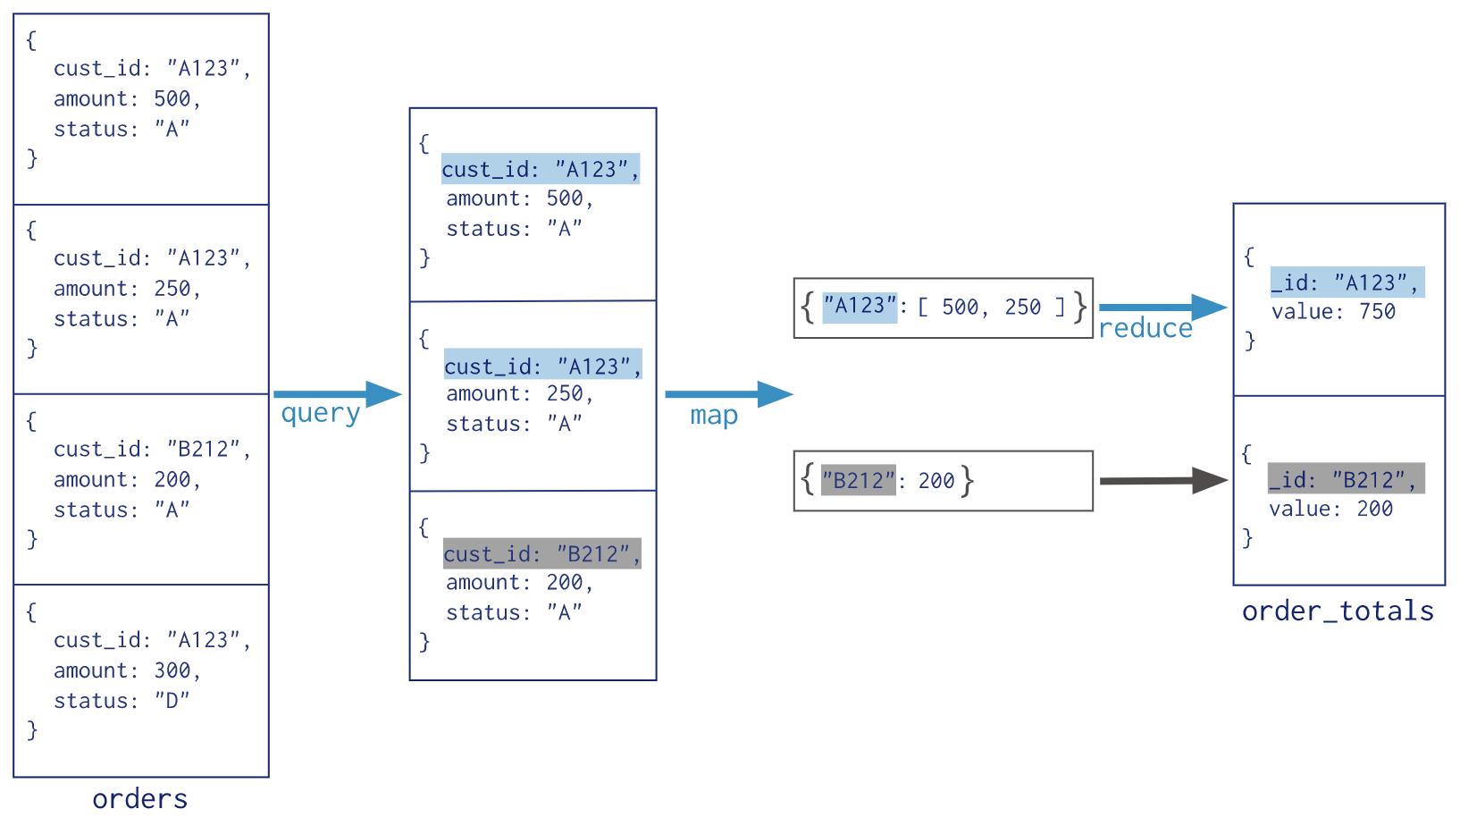
MapReduce Example

Slide 90
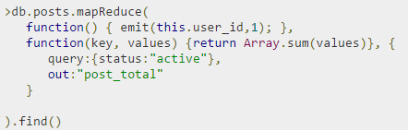
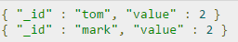
MapReduce Example
Result
Indicates that both users tom and mark have two posts in active states.

Slide 91
MapReduce
db.collection.mapReduce(
mapFunction,
reduceFunction,
options
)

Slide 92
MapReduce
db.cities.mapReduce(
mapPopulation,
reducePopulation,
options
)

Slide 93
MapReduce
function mapPopulation(){
emit(this.city, this.population)
}
“city” and “population” are fields on “this” document
“this”document is a zip-code indexed document from the input set

Slide 94
MapReduce
_id: 01001
city: “AGAWAM”, …,
population: NumberInt(15338)
_id: 01002
city: “CUSHMAN”, …,
population: NumberInt(36963)
emit(this.city, this.population)?
{”AGAWAM”: NumberInt(15338)}
{”CUSHMAN”: NumberInt(36963)}

Slide 95
MapReduce
function reduce(key, values){
return Array.sum(values);
}
”key” is city name, “values” is an array of population from multiple documents

Slide 96
MapReduce
function reduce(city_name, populations_per_zip){
return Array.sum(populations_per_zip);
}
”key” is city name, “values” is an array of population from multiple documents
city_name => “AGAWAM”
populations_per_zip => [NumberInt(15338)]

Slide 97
MapReduce
_id: ObjectId("52cdef7c4bab8bd675297d8a"),
name: "Wetpaint",
tag_list: "wiki, seattle, elowitz, media-industry, media-platform, social-distribution-system"
_id: ObjectId("52cdef7c4bab8bd675297d8c"),
name: "Zoho",
tag_list: "zoho, officesuite, spreadsheet, writer, projects, sheet, crm, show, creator, wiki, planner, suite, notebook, chat, meeting, mail"
How would you aggregate tags with MapReduce?

Slide 98
MapReduce
_id: ObjectId("52cdef7c4bab8bd675297d8a"),
name: "Wetpaint",
tag_list: "wiki, seattle, elowitz, media-industry, media-platform, social-distribution-system”
function mapTags(){
?????????
}
function reduceTags(key, values){
??????
}

Slide 99
MapReduce
_id: ObjectId("52cdef7c4bab8bd675297d8a"),
name: "Wetpaint",
tag_list: "wiki, seattle, elowitz, media-industry, media-platform, social-distribution-system”
function mapTags(){
var tags = this.tag_list.split(”,”);
for (var i = 0; i < tags.length; i++){
emit(tags[i], 1);
}
}

Slide 100
MapReduce
_id: ObjectId("52cdef7c4bab8bd675297d8a"),
name: "Wetpaint",
tag_list: "wiki, seattle, elowitz, media-industry, media-platform, social-distribution-system”
function reduceTags(key, values){
return Array.sum(values);
}

